Slide 1






Maximizing the Bandwidth Multiplier Effect for Hybrid Cloud-P2P Content Distribution
Zhenhua Li | Tieying Zhang | Yan Huang | Zhi-Li Zhang | Yafei Dai
Peking University, Beijing, China | Chinese Academy of Sciences, Beijing, China | Tencent Research, Shanghai, China | University of Minnesota, Twin Cities, USA | Peking University, Beijing, China
Contact email: lizhenhua1983@gmail.com

Slide 2





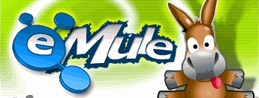

Internet Content Distribution
Content distribution
- Distribute digital content from source to end hosts
- Fundamental function of the Internet
Today’s Internet content distribution mainly works in two modes:
1. Cloud-based
- Rely on huge data centers
- Often utilize CDNs for data delivery
- Require massive/costly infrastructure
2. P2P (peer-to-peer)
- Rely on numerous end users
- Often highly scalable while dynamic
- Performance: unstable/unpredictable
storage
delivery
Amazon Cloud

Slide 3
Hybrid Cloud-P2P Content Distribution
A third approach --- Hybrid Cloud-P2P Content Distribution
- Recently emerges as a promising alternative
- Addresses the potential limitations of Cloud-based and P2P
- and inherits the advantages of both
- The cloud not only provides cloud “seeds”
- but also assist end users to find other peers interested in the same content
Compared to Cloud-based:
- Far lower infrastructure and CDN cost
Compared to P2P:
- Provide extra cloud bandwidth to those peer swarms who do not work well for lack of seed peers

Slide 4






Typical CloudP2P Systems
Youku
- China’s biggest video sharing site
- Cloud bandwidth expense consumed over half of its total income
- Encouraging its users to install iKu accelerator
- Cloud-based (Youku) → CloudP2P (iKu)
PPLive, UUSee
- P2P video streaming
- Often suffered unstable service to users
- P2P → CloudP2P
Xunlei (Thunder), Xuanfeng (Cyclone)
- Popular CloudP2P file sharing systems
- millions of users per day

Slide 5
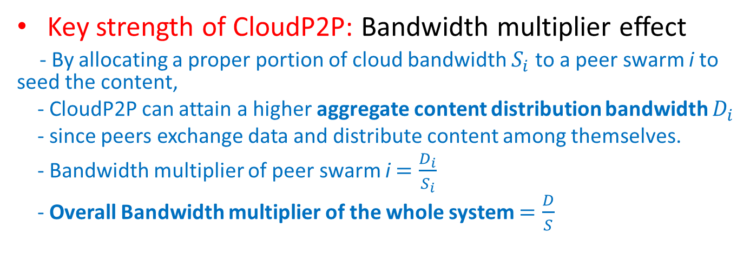
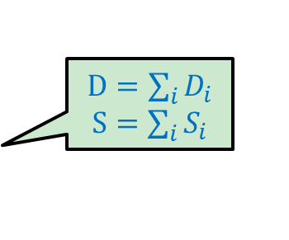
Bandwidth Multiplier Effect
Key strength of CloudP2P: Bandwidth multiplier effect
- By allocating a proper portion of cloud bandwidth $S_{i}$ to a peer swarm i to seed the content,
- CloudP2P can attain a higher aggregate content distribution bandwidth $D_{i}$
- since peers exchange data and distribute content among themselves.
- Bandwidth multiplier of peer swarm i $=\frac{D_{i}}{S_{i}}$
- Overall Bandwidth multiplier of the whole system $=\frac{D}{S}$
$D=\sum_{i}{D_{i}}$ $S=\sum_{i}{S_{i}}$
OBAP (Optimal Bandwidth Allocation Problem)
- A major problem in the design of CloudP2P
- How to allocate cloud bandwidth to peer swarms so as to maximize the overall bandwidth multiplier effect of the whole system?
?
?
?

Slide 6
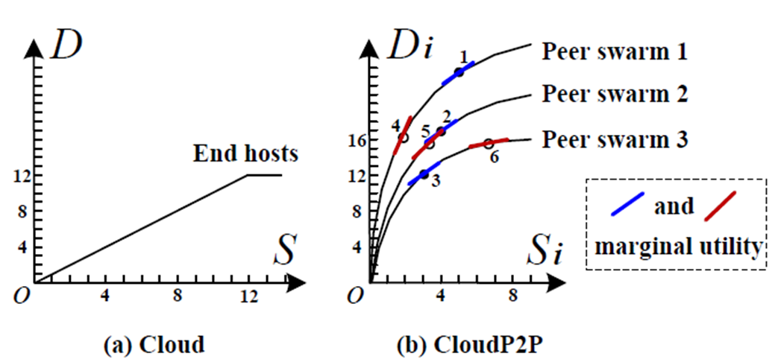
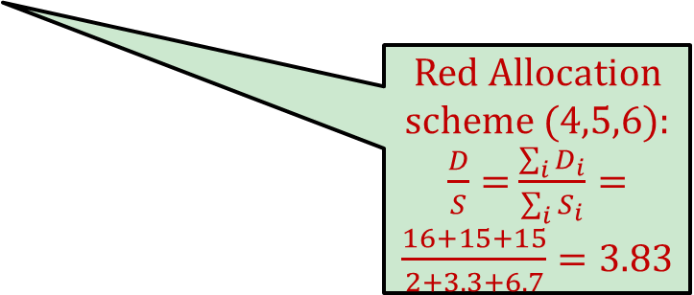
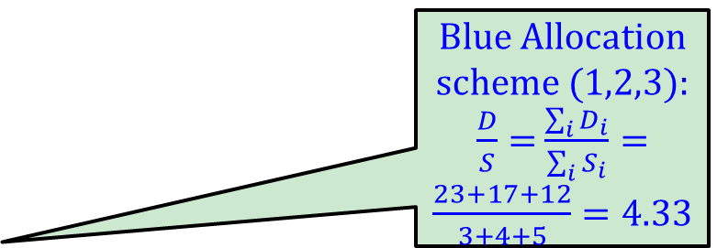
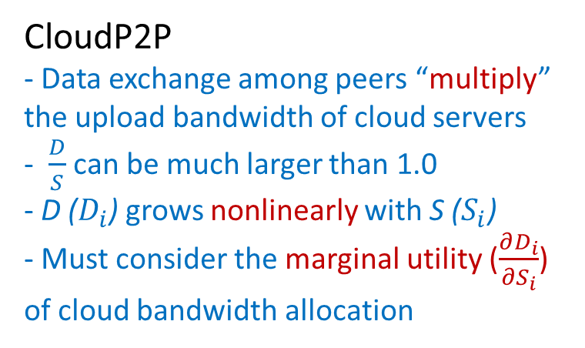
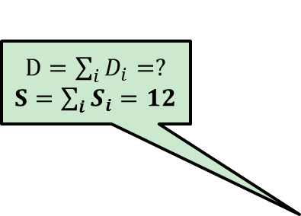
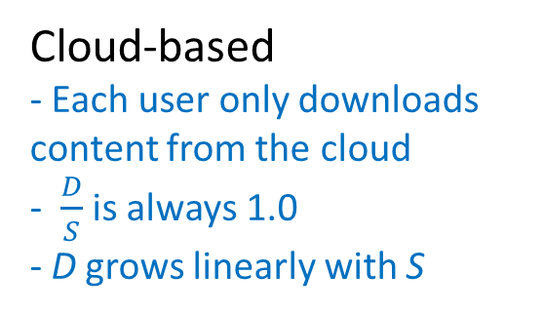
A Simple Example
Blue Allocation scheme (1,2,3):
$\frac{D}{S}=$ $\frac{\sum_{i}{D_{i}}}{\sum_{i}{S_{i}}}=$ $\frac{23+17+12}{3+4+5}=4.33$
$D=\sum_{i}{D_{i}}=?$ $S=\sum_{i}{S_{i}}=12$
Red Allocation scheme (4,5,6):
$\frac{D}{S}=$ $\frac{\sum_{i}{D_{i}}}{\sum_{i}{S_{i}}}=$ $\frac{16+15+15}{2+3.3+6.7}=3.83$
Cloud-based
- Each user only downloads content from the cloud
- $\frac{D}{S}$ is always 1.0
- D grows linearly with S
CloudP2P
- Data exchange among peers “multiply” the upload bandwidth of cloud servers
- $\frac{D}{S}$ can be much larger than 1.0
- D ($D_{i}$) grows nonlinearly with S ($S_{i}$)
- Must consider the marginal utility ($\frac{∂D_{i}}{{∂S}_{i}}$) of cloud bandwidth allocation
Intuitively, we find larger bandwidth multiplier implies more balanced marginal utilities among peer swarms (formally proved in our paper)

Slide 7


Existing CloudP2P Bandwidth Allocation Algorithms
Free-competitive algorithm
- All peers freely compete for cloud bandwidth
- benefits those aggressive or selfish peer swarms
Proportional-allocate algorithm
- Allocates more cloud bandwidth to bigger swarm
- Ideal assumption: demand of cloud bandwidth only depends on swarm scale
AntFarm (NSDI’09)
- Allocates seed peers’ bandwidth to leechers
- Does not consider the cloud bandwidth
Ration (INFOCOM’08, TON’11)
- Allocates cloud bandwidth to leechers
- Does not consider the seed peers’ bandwidth
Both good works on CloudP2P bandwidth allocation!
What’s the value of our work?

Slide 8



Our work vs. AntFarm & Ration
 | AntFarm | Ration | FIFA (Our work)
Working environment | Pure P2P | CloudP2P live TV streaming (more homogeneous and stable) | CloudP2P file sharing (heterogeneous and dynamic)
Performance model | Only consider leechers and seeders | Only consider leechers and cloud | Consider cloud, leechers and seeders → “Fine-grained” model
Iterative algorithm | Hill climbing | Water filling | “Fast-convergent” iterative algorithm
Experiments | Planetlab prototype | UUSee trace driven simulation | Xuanfeng (Cyclone) trace driven simulation + CoolFish prototype
Not this FIFA ☺
FIFA

Slide 9
FIFA =
Fine-grained performance model (FI)
+ Fast-convergent iterative algorithm (FA)

Slide 10
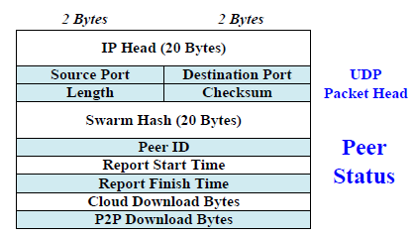
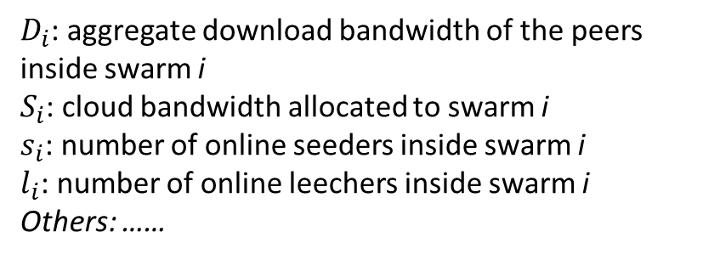
Key Impact Factors
A number of factors may impact the bandwidth multiplier of a peer swarm
- E.g., allocated cloud bandwidth, number of leechers, number of seeders, available bandwidth of each peer, connection topology among peers, and so forth.
Impossible/unnecessary to take all into account
Our methodology: find out the key impact factors
- Utilize real-world measurements from Xuanfeng (Cyclone)
- Contain 1457 swarms in one day, involving 1,000,000 peers
- Record multiple performance parameters per 5 minutes
$D_{i}$: aggregate download bandwidth of the peers inside swarm i
$S_{i}$: cloud bandwidth allocated to swarm i
$s_{i}$: number of online seeders inside swarm i
$l_{i}$: number of online leechers inside swarm i
Others: ……

Slide 11
Basic Relationships between Impact Factors
Look like exponential relation?
Really approximate exponential relation?

Slide 12
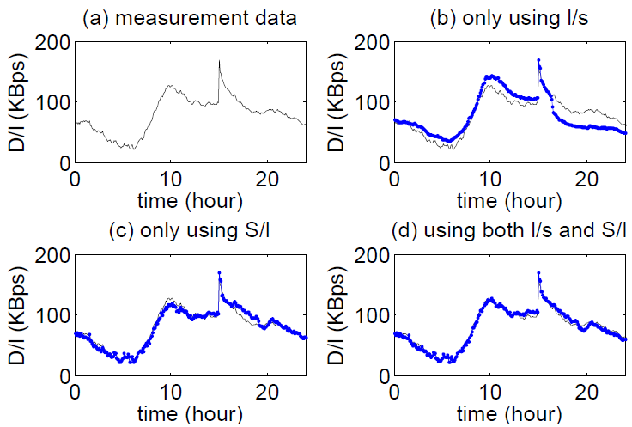
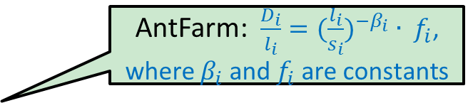
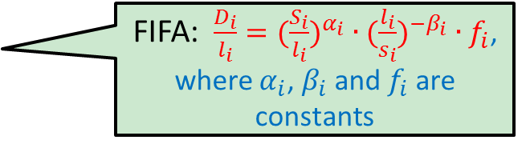
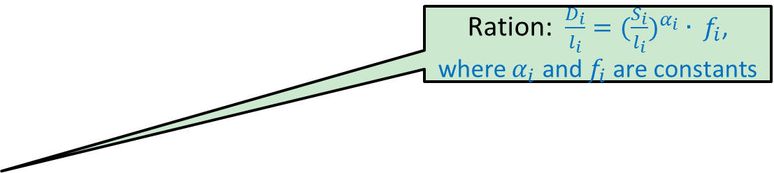
What We Need is the Accurate Relationships!
AntFarm: $\frac{D_{i}}{l_{i}}={(\frac{l_{i}}{s_{i}})}^{−β_{i}} ∙ f_{i}$, where $β_{i}$ and $f_{i}$are constants
Bad fitting
Ration: $\frac{D_{i}}{l_{i}}={(\frac{S_{i}}{l_{i}})}^{α_{i}} ∙ f_{i}$, where $α_{i}$ and $f_{i}$are constants
Very Good!
FIFA: $\frac{D_{i}}{l_{i}}={(\frac{S_{i}}{l_{i}})}^{α_{i}} ∙{(\frac{l_{i}}{s_{i}})}^{−β_{i}} ∙f_{i}$, where $α_{i}$, $β_{i}$ and $f_{i}$are constants
Good fitting
Fine-grained performance model!
Modeling the performance of a typical swarm using different combination of impact factors

Slide 13
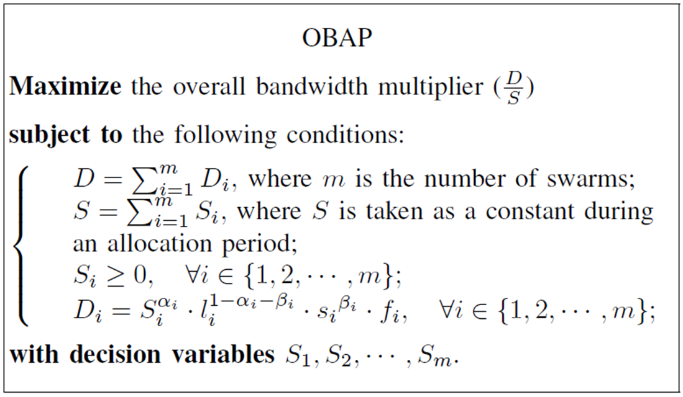
OBAP (Optimal Bandwidth Allocation Problem)
OBAP is a constrained nonlinear optimization problem (skip the equations!)

Slide 14
Theorem for OBAP
Theorem 1. For CloudP2P content distribution, the maximum bandwidth multiplier implies that the marginal utility of the cloud bandwidth allocated to each peer swarm should be equal.
- The proof can be found at http://net.pku.edu.cn/~lzh/papers/[IWQoS'12]%20FIFA.pdf
- In practice, we want the relative deviation of marginal utility among peer swarms to be as little as possible, i.e., larger bandwidth multiplier implies more balanced marginal utilities among peer swarms.
Why cannot we make all marginal utilities to be exactly equal?

Slide 15
FIFA =
Fine-grained performance model (FI)
+ Fast-convergent iterative algorithm (FA)

Slide 16
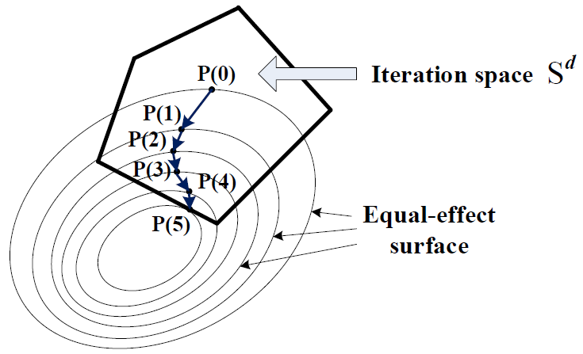
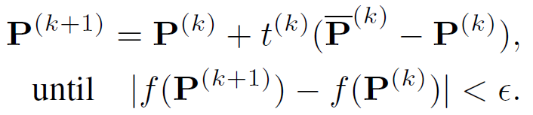
How to solve the OBAP problem?
OBAP is a constrained nonlinear optimization problem
- The optimal solution of such a problem is typically obtained via iterative operations in multiple steps until the algorithm converges
Convergence property of an iterative algorithm
- 1) iteration direction, 2) iteration stepsize.
Iteration stepsize
Iteration direction

Slide 17

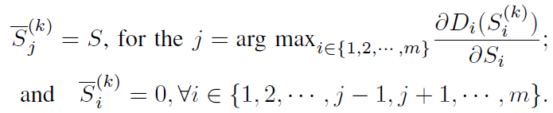

FA: Our proposed Fast-convergent iterative algorithm (skip the details ☺)
Iteration direction
- Conditional gradient method
- Always walks in the direction of deepest “gradient”
Iteration stepsize
- Armijo rule
- Adaptively setts the stepsize in each iteration step

Slide 18
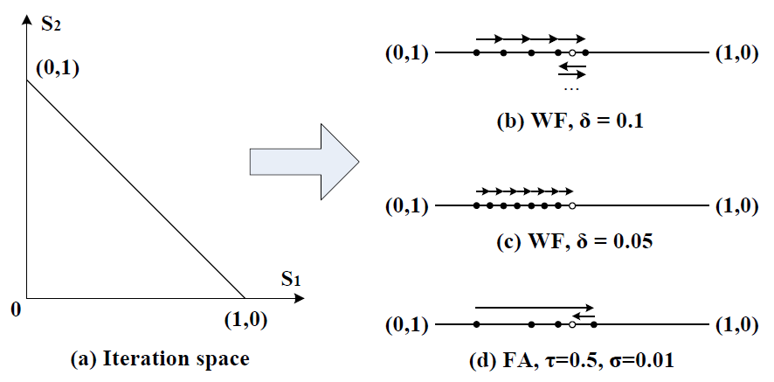
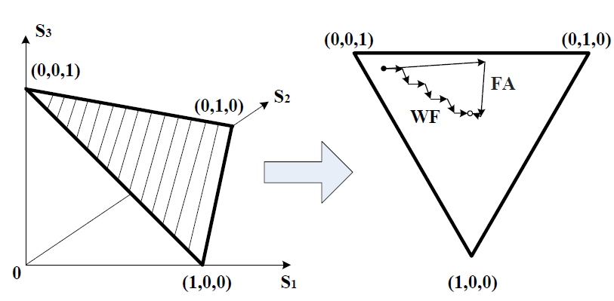
Comparison among three iterative algorithms
HC – Hill-climbing
- Only walks in one dimension
- Uses a constant stepsize
- May converge very slowly and even does not converge
WF – Water-filling
- Walks in two dimensions
- Also uses a constant stepsize
- May converge slowly and even does not converge
FA – Fast-convergent
- Walks in all dimensions!
- Adaptively sets stepsize!
- Converge fast and provably!
2-dimension example
3-dimension example

Slide 19
Performance Evaluation =
Xuanfeng (Cyclone) trace driven simluation + CoolFish Prototype Implementation

Slide 20
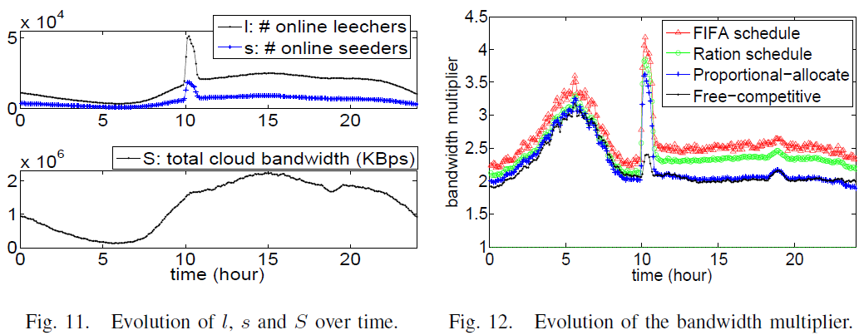
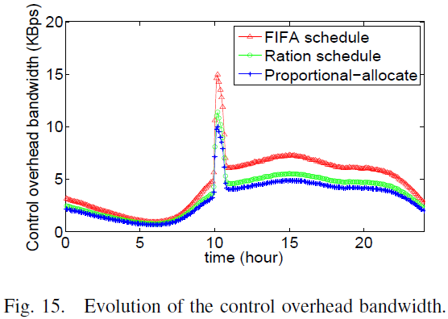
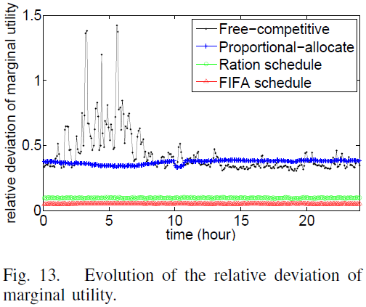
Xuanfeng (Cyclone) System Trace Driven Simulation
One-day trace from 1457 swarms involving 1,000,000 peers

Slide 21
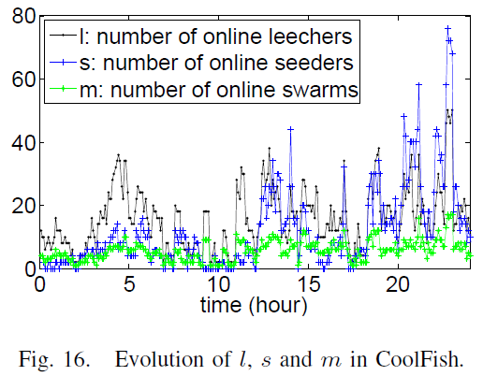
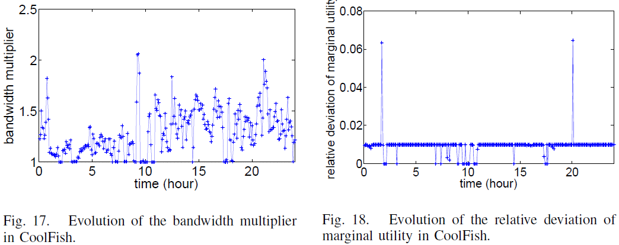
CoolFish Prototype Implementation
CoolFish
- Web site: http://www.cool-fish.org
- CloudP2P VoD streaming system
- A “micro” cloud composed of 4 servers
- Much smaller than Xuanfeng (Cyclone)
system but easy to deploy and control

Slide 22

The End

Slide 23
Appendix: Why we do not implement FIFA on top of the Xuanfeng system?
1. Accurate cloud bandwidth allocation in a huge-scale CloudP2P system is really not easy
- On CoolFish, we replicate all videos into all the 4 servers
- On Xuanfeng, each video is replicated into only a small subset of the thousands of cloud servers → data migration costs both intra-cloud bandwidth and server storage
2. The numerous cloud servers of Xuanfeng are deployed in multiple cities and ISPs in China
3. A nontrivial portion of cloud servers are controlled by third-party companies rather than Tencent (Xuanfeng group)

